Slide 1
Estimation of the degradation function
There are three ways it can be estimated
Observation
Experimentation
Mathematical Modeling

Slide 2
Estimation by Image Observation
Let the image is degraded by an unknown degradation function H.
Assume that H is linear and position invariant.
Gather information from the image.
Look at the small rectangular section of a blurred image, which contain sample structure.

Slide 3
To reduce the noise effect , look at the strong signal content area (area of high contrast).
Now process the sub-image to arrive at a result that it a unblurred as possible.
(Using sharpening filter or by processing small areas in hand)
Let the observed sub-image be denoted by
g_{s} (x, y)
and the processed sub-image f^{ˆ} (x, y)
s

Slide 4
Assuming negligible noise effect , we have
G (u, v)
H (u, v) =
s
s
F (u, v)
s
Based on the information of Position invariance, we can deduce complete degradation function H(u,v) from the characteristics of above function

Slide 5
Suppose the radial plot of H_{s}(u,v) has the approximate shape of the Gaussian curve , same information is used for H(u,v) in the larger scale.

Slide 6
Estimation by Experimentation
If the equipment, with which we obtained the degraded image is available, accurate estimation of the degradation function can be obtained.
With various system settings of the equipments, obtain a degraded as closely as possible to the given degraded image.

Slide 7
Using the system settings (Response) get an impulse response by imaging an impulse (small dot of light.
An impulse is simulated by bright dot of light as bright as possible to reduce the effect of noise to negligible value.

Slide 8
Then Fourier transform of an impulse is a constant
H (u, v) = ^{G(u, v)}
A
Where A is constant describing strength of the impulse.

Slide 9
The mathematical degradation model proposed by Hufnagel and Stanley [1964] is based on the
Estimation by modeling
physical characteristics of the atmospheric turbulence.
2 2 ⁵
H (u, v) = e^{−k (u +v ) 6}
Where k is the constant depends on the nature of the turbulence.

Slide 10
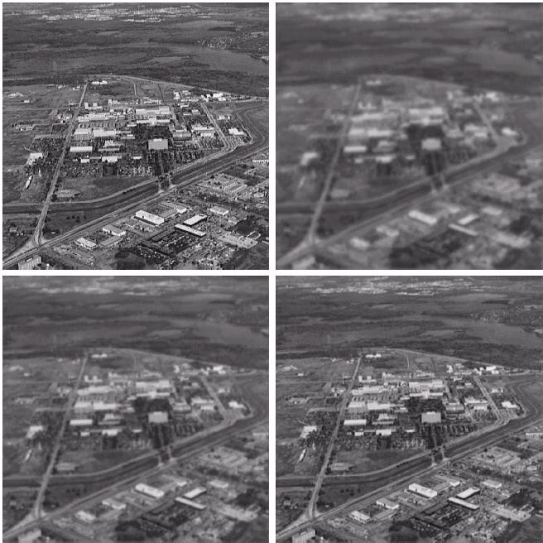
Image with severe turbulence k=0.0025
Image with negligible turbulence
Image with mild turbulence k=0.001
Image with low turbulence k=0.00025

